Slide 1
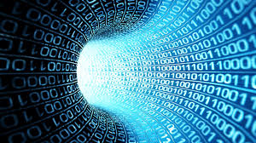
How Computers Work

Slide 2
01001100101010111001010000101
What is a Computer?
What would you expect to see?
01001100101010111001010000101
Notes:
Students to draw what they think a computer is on paper or whiteboards.

Slide 3


























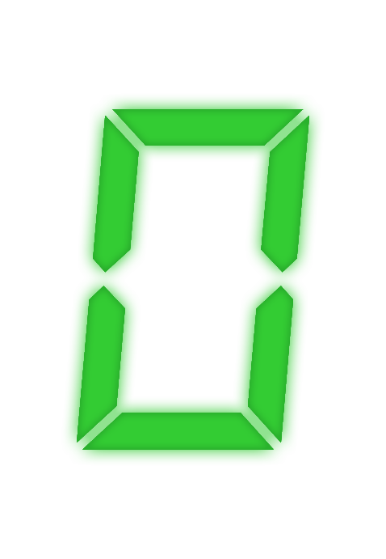


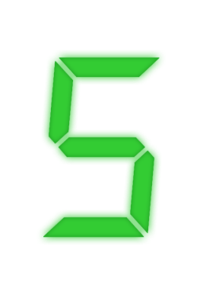
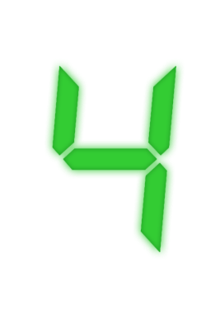
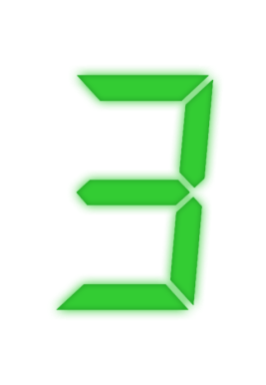
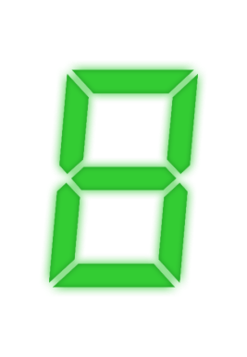

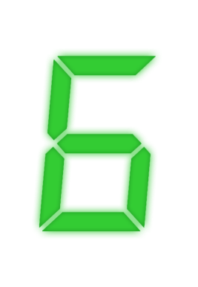
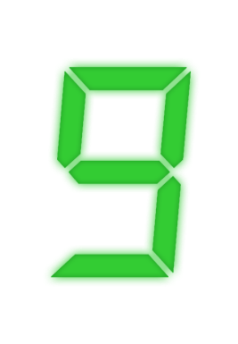




































Slide 5
Times
Up

Slide 6

A Computer
Is a machine which responds to instructions to complete a task.
Or…
A device which takes input data, processes it and outputs the result.
Instructions
Results
Input
Processing
output

Slide 7
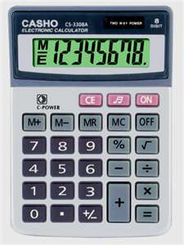
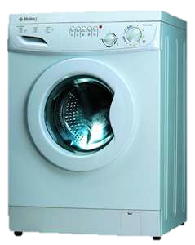
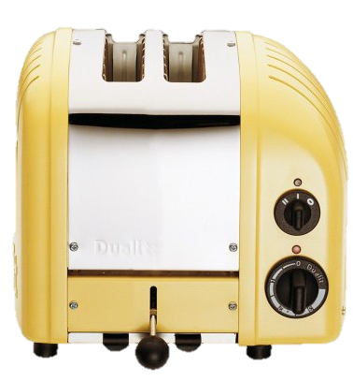
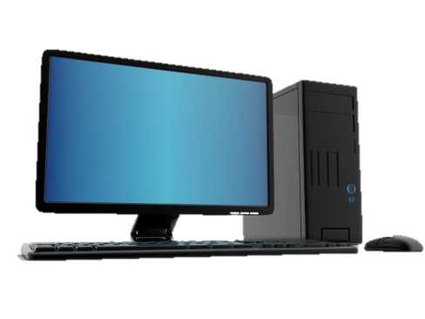
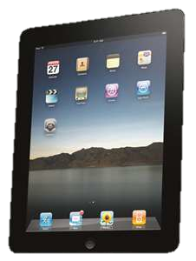
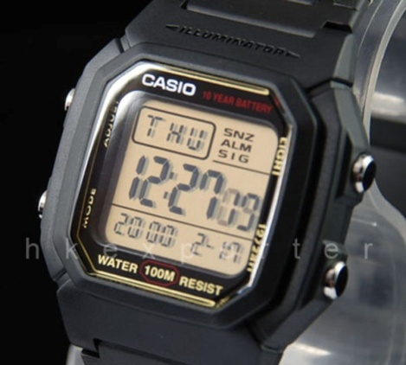
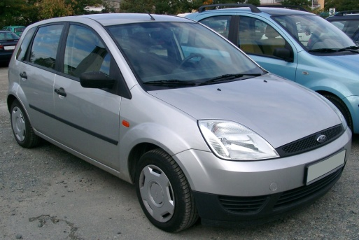
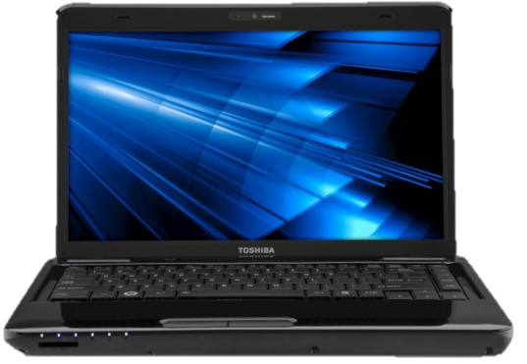
Which of these is a computer
A
B
C
D
E
F
G
H
Notes:
The answer is all of them

Slide 8
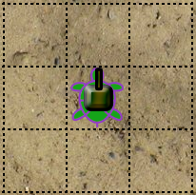
Battle Turtles
This is a turtle.
It has a cannon on its shell.
It can do many things.
But, you must tell it what to do.

Slide 9
Battle Turtles
The turtle understands a small collection of commands – instruction set.
The turtle can also be told to recognise a number, like you did with variables in Python – data labels.
The turtle has special locations that can store numbers – registers (e.g. Accumulator/ACC).
The turtle can be instructed to move and turn amongst many other things – output channels.

